Slide 1


CS 188: Artificial Intelligence
Constraint Satisfaction Problems
Instructor: Anca Dragan
University of California, Berkeley
[These slides adapted from Dan Klein and Pieter Abbeel]
Notes:
Please retain proper attribution, including the reference to ai.berkeley.edu. Thanks!

Slide 2

Constraint Satisfaction Problems
N variables
domain D
constraints
x₂
x₁
states
goal test
successor function
partial assignment
complete; satisfies constraints
assign an unassigned variable
Notes:
What is a csp? guess
coloring problem; why does this make sense as problem? silly but good representation for real world problems, e.g. scheduling tasks that need resources – can’t run 2 tasks at the same time if they need the same resource
CSPs as a search problem?

Slide 3


What is Search For?
Assumptions about the world: a single agent, deterministic actions, fully observed state, discrete state space
Planning: sequences of actions
The path to the goal is the important thing
Paths have various costs, depths
Heuristics give problem-specific guidance
Identification: assignments to variables
The goal itself is important, not the path
All paths at the same depth (for some formulations)
CSPs are specialized for identification problems
Notes:
Step back – these are search problems, so we can now take a look at different problems we can use search for
Before we had planning;
Ninja robot knows where the gem is, but not how to get there
Identification; detective robot wants to know where the gem is – the goal is important, not the path; what is the depth?

Slide 4


Constraint Satisfaction Problems
Standard search problems:
State is a “black box”: arbitrary data structure
Goal test can be any function over states
Successor function can also be anything
Constraint satisfaction problems (CSPs):
A special subset of search problems
State is defined by variables X_{i} with values from a domain D (sometimes D depends on i)
Goal test is a set of constraints specifying allowable combinations of values for subsets of variables
Allows useful general-purpose algorithms with more power than standard search algorithms
Notes:
Before: states were nodes, no structure, just a set, they could be anything
Goal test – like a judge; just makes decisions; you don’t know how;
Now: Goal test has structure, it ‘s more like a manual describing a set of constraints that have to hold true

Slide 5
CSP Examples
Notes:
I want you to practice formalizing real problems as search/csp problems

Slide 6


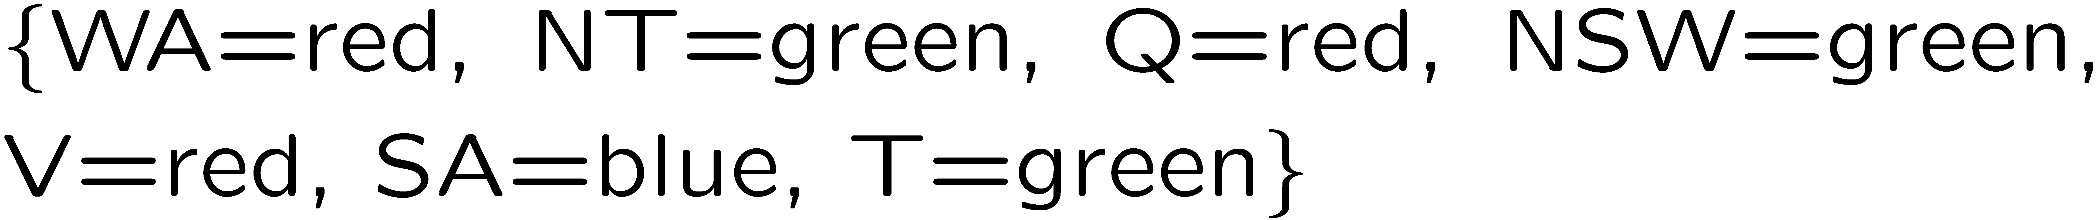
Example: Map Coloring
Variables:
Domains:
Constraints: adjacent regions must have different colors
Solutions are assignments satisfying all constraints, e.g.:
Implicit:
Explicit:
Notes:
How do you specify constraints in code/math? Implicit vs explicit. What might be explicit?

Slide 7
Constraint Graphs

Slide 8
Constraint Graphs
Binary CSP: each constraint relates (at most) two variables
Binary constraint graph: nodes are variables, arcs show constraints
General-purpose CSP algorithms use the graph structure to speed up search. E.g., Tasmania is an independent subproblem!
Notes:
Demo:
Run constraint.jar or constraint.exe, load the 5 queens problem.
Demo is just showing the n-queens applet as illustration of constraint graph, but later in lecture we’ll interact with the applet.
aispace.org will have the latest version

Slide 9


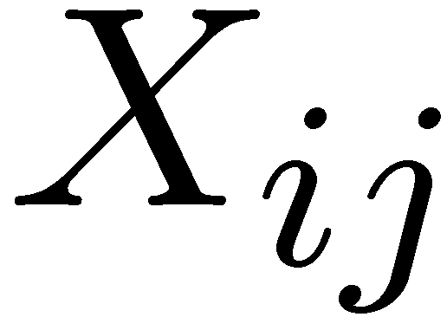

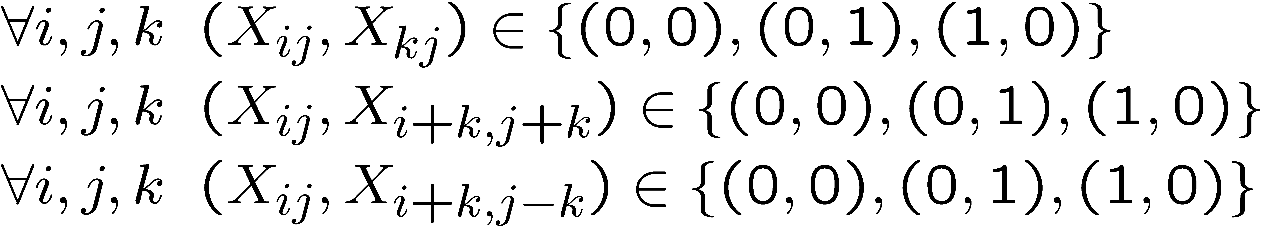
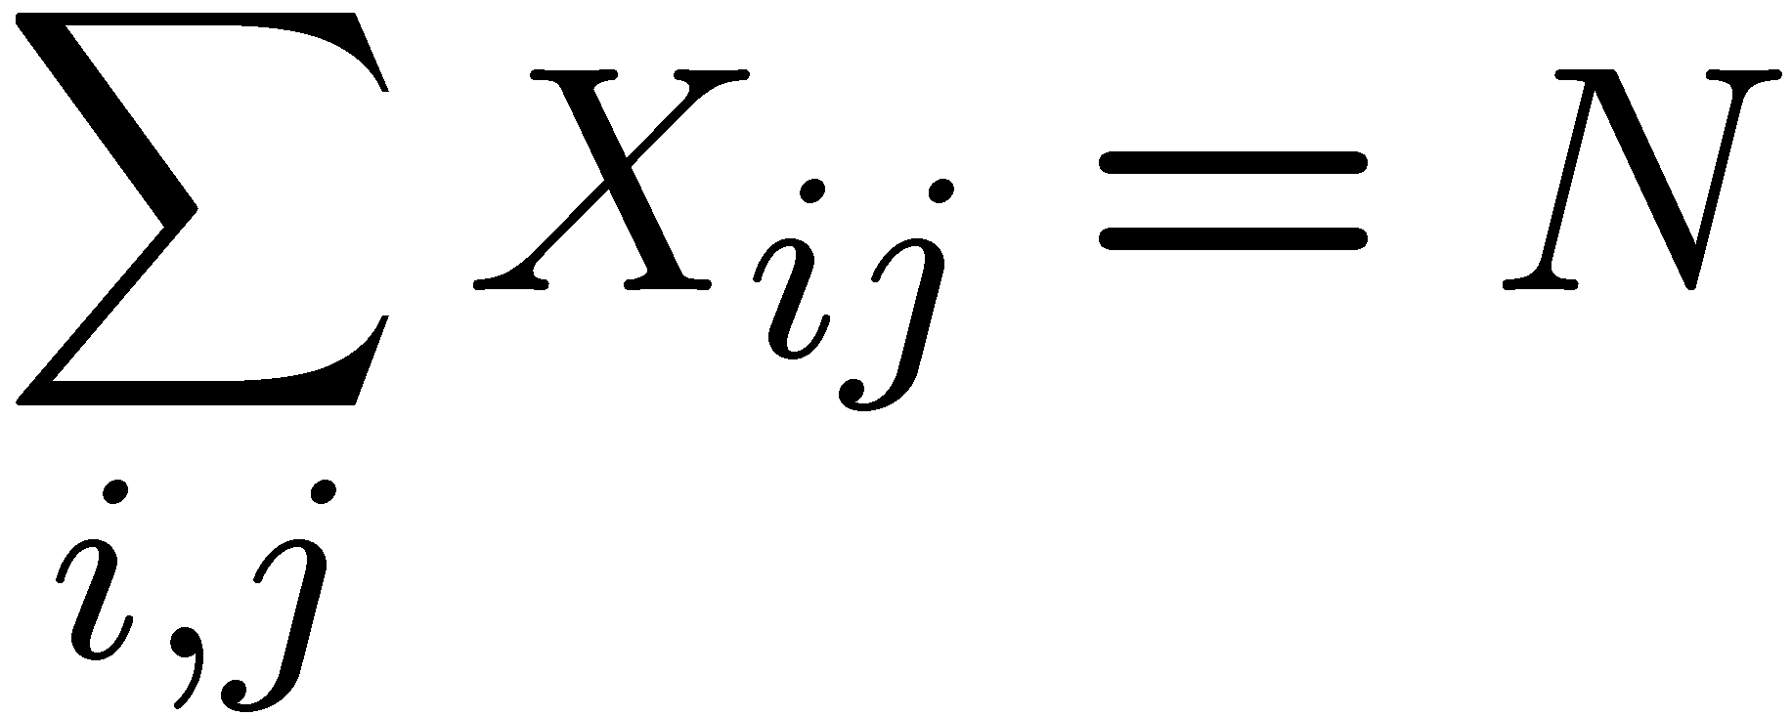
Example: N-Queens
Formulation 1:
Variables:
Domains:
Constraints
Notes:
Are these constraints enough? No, there should be N queens there.

Slide 10







Example: N-Queens
Formulation 2:
Variables:
Domains:
Constraints:
Implicit:
Explicit:

Slide 11
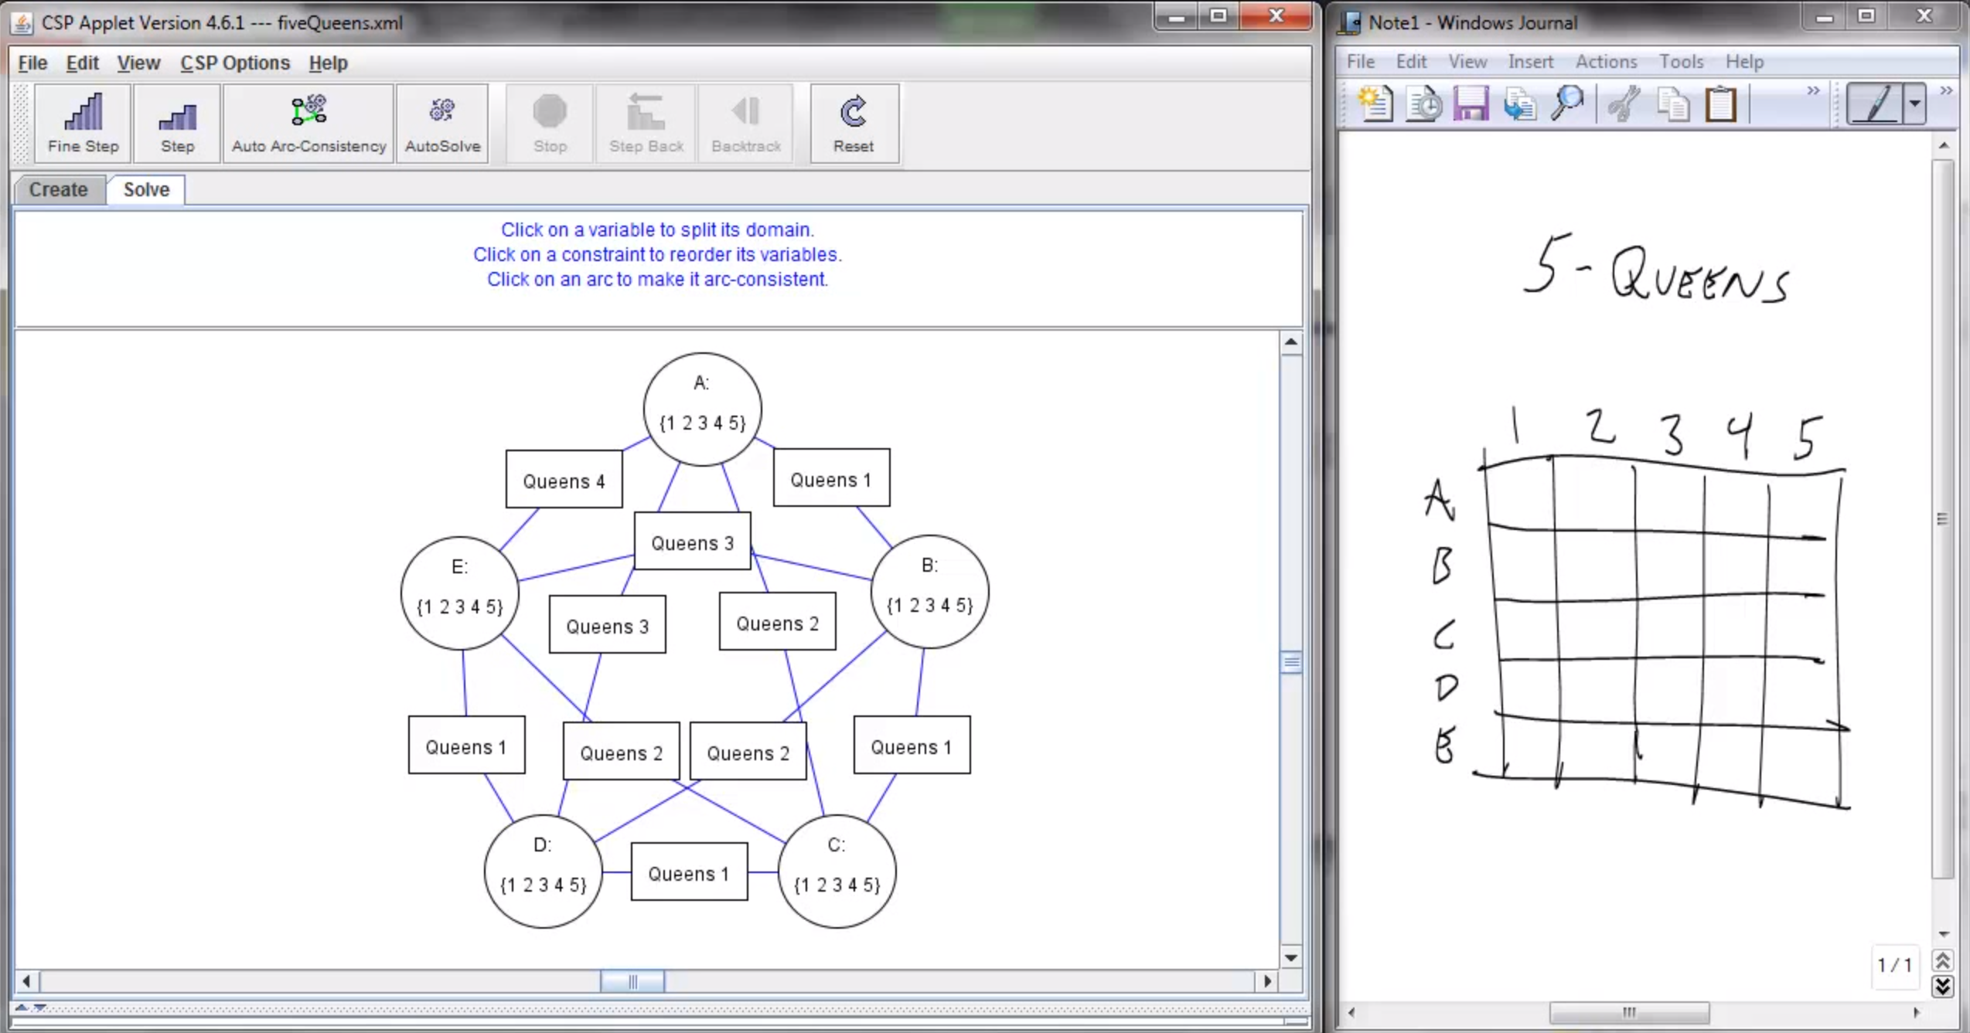
Screenshot of Demo N-Queens
Notes:
Note: the n-queens demo is used later as a demo; at this stage in lecture just the above is shown and talked about without engaging in any interaction with the applet.

Slide 12


Example: Cryptarithmetic
X₁
Variables:
Domains:
Constraints:
Notes:
0=7, R=4, W=6, U=2, T=8, F=1; 867 + 867 = 1734

Slide 13
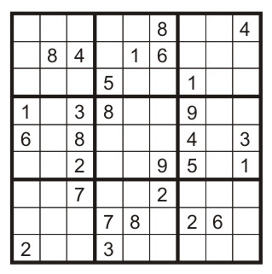
Example: Sudoku
Variables:
Each (open) square
Domains:
{1,2,…,9}
Constraints:
9-way alldiff for each column
9-way alldiff for each row
9-way alldiff for each region
(or can have a bunch of pairwise inequality constraints)

Slide 14
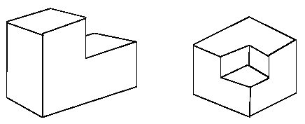
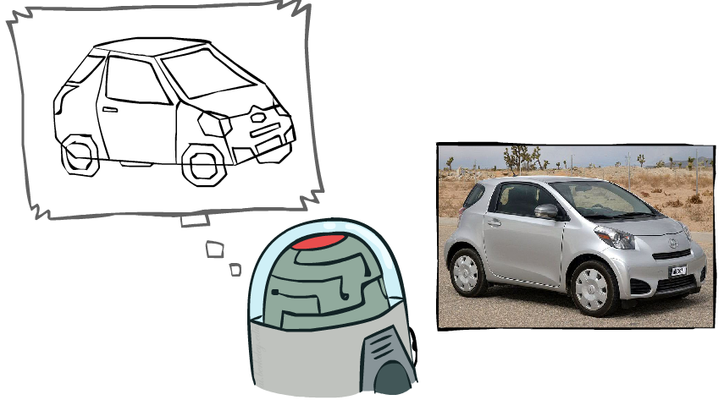
Example: The Waltz Algorithm
The Waltz algorithm is for interpreting line drawings of solid polyhedra as 3D objects
An early example of an AI computation posed as a CSP
?
Approach:
Each intersection is a variable
Adjacent intersections impose constraints on each other
Solutions are physically realizable 3D interpretations

Slide 15


Example: The Waltz Algorithm
The Waltz algorithm is for interpreting line drawings of solid polyhedra as 3D objects
An early example of an AI computation posed as a CSP
?
Approach:
Each intersection is a variable
Adjacent intersections impose constraints on each other
Solutions are physically realizable 3D interpretations

Slide 16
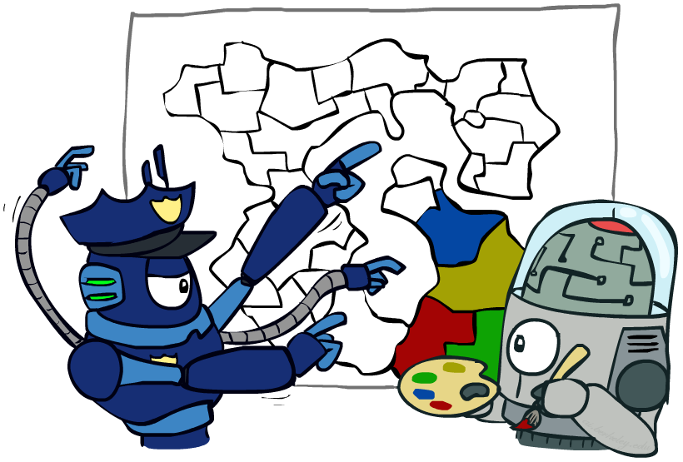
Varieties of CSPs and Constraints

Slide 17


Varieties of CSPs
Discrete Variables
Finite domains
Size d means O(d^{n}) complete assignments
E.g., Boolean CSPs, including Boolean satisfiability (NP-complete)
Infinite domains (integers, strings, etc.)
E.g., job scheduling, variables are start/end times for each job
Linear constraints solvable, nonlinear undecidable
Continuous variables
E.g., start/end times for Hubble Telescope observations
Linear constraints solvable in polynomial time by LP methods (see cs170 for a bit of this theory)

Slide 18


Varieties of Constraints
Varieties of Constraints
Unary constraints involve a single variable (equivalent to reducing domains), e.g.:
Binary constraints involve pairs of variables, e.g.:
Higher-order constraints involve 3 or more variables:
e.g., cryptarithmetic column constraints
Preferences (soft constraints):
E.g., red is better than green
Often representable by a cost for each variable assignment
Gives constrained optimization problems
(We’ll ignore these until we get to Bayes’ nets)

Slide 19
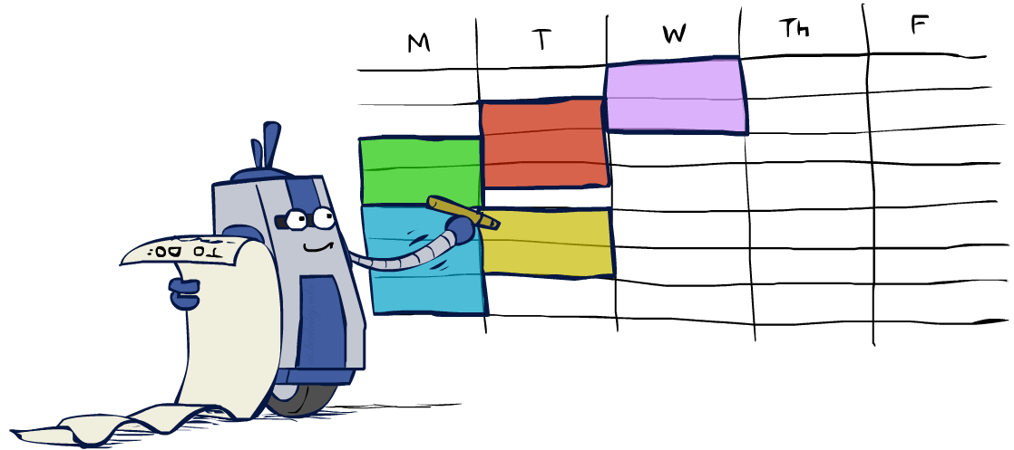
Real-World CSPs
Assignment problems: e.g., who teaches what class
Timetabling problems: e.g., which class is offered when and where?
Hardware configuration
Transportation scheduling
Factory scheduling
Circuit layout
Fault diagnosis
… lots more!
Many real-world problems involve real-valued variables…

Slide 20

Solving CSPs

Slide 21
Standard Search Formulation
Standard search formulation of CSPs
States defined by the values assigned so far (partial assignments)
Initial state: the empty assignment, {}
Successor function: assign a value to an unassigned variable
Goal test: the current assignment is complete and satisfies all constraints
We’ll start with the straightforward, naïve approach, then improve it

Slide 22
Search Methods
What would BFS do?
{}
{WA=g}
{WA=r}
…
{NT=g}
…
[Demo: coloring -- dfs]
Notes:
Where is the goal? If BFS were a person, this is what would keep it up at night.
Demo:
CS188 javascript demos -> source -> exercises -> csps -> CSPs demos -> CSPs demos.html
Settings:
Graph = Simple
Algorithm = Naïve Search
Ordering = None
Filtering = None

Slide 23
Search Methods
What would BFS do?
What would DFS do?
let’s see!
What problems does naïve search have?
[Demo: coloring -- dfs]
Notes:
Demo:
CS188 javascript demos -> source -> exercises -> csps -> CSPs demos -> CSPs demos.html
Settings:
Graph = Simple
Algorithm = Naïve Search
Ordering = None
Filtering = None

Slide 24

Video of Demo Coloring -- DFS

Slide 25

Backtracking Search

Slide 26
Backtracking Search
Backtracking search is the basic uninformed algorithm for solving CSPs
Idea 1: One variable at a time
Variable assignments are commutative, so fix ordering -> better branching factor!
I.e., [WA = red then NT = green] same as [NT = green then WA = red]
Only need to consider assignments to a single variable at each step
Idea 2: Check constraints as you go
I.e. consider only values which do not conflict previous assignments
Might have to do some computation to check the constraints
“Incremental goal test”
Depth-first search with these two improvements
is called backtracking search (not the best name)
Can solve n-queens for n ≈ 25
Notes:
Incremental goal test possible because we have the csp structure and the goal test is not a black box

Slide 27
Backtracking Example
[Demo: coloring -- backtracking]

Slide 28
Video of Demo Coloring – Backtracking
Notes:
Will it backtrack? Yes.

Slide 29
Backtracking Search
Backtracking = DFS + variable-ordering + fail-on-violation
What are the choice points?
Notes:
We havent talked about the ordering, so lets just assume its some random ordering for now.

Slide 30

Improving Backtracking
General-purpose ideas give huge gains in speed
Ordering:
Which variable should be assigned next?
In what order should its values be tried?
Filtering: Can we detect inevitable failure early?

Slide 31

Filtering
Keep track of domains for unassigned variables and cross off bad options

Slide 32
Filtering: Forward Checking
Filtering: Keep track of domains for unassigned variables and cross off bad options
Forward checking: Cross off values that violate a constraint when added to the existing assignment
WA
NT
Q
SA
NSW
V
[Demo: coloring -- forward checking]
Notes:
Demo:
CS188 javascript demos -> source -> exercises -> csps -> CSPs demos -> CSPs demos.html
Settings:
Graph = Simple
Algorithm = Backtracking
Ordering = None
Filtering = Forward Checking

Slide 33
Video of Demo Coloring – Backtracking with Forward Checking

Slide 34
Filtering: Constraint Propagation
Forward checking propagates information from assigned to unassigned variables, but doesn't provide early detection for all failures:
NT and SA cannot both be blue!
Why didn’t we detect this yet?
Constraint propagation: reason from constraint to constraint
NT
Q
WA
SA
NSW
V
Notes:
We’ve already failed, but forward checking does not detect that.

Slide 35

Consistency of A Single Arc
An arc X → Y is consistent iff for every x in the tail there is some y in the head which could be assigned without violating a constraint
Forward checking?
Enforcing consistency of arcs pointing to each new assignment
NT
Q
WA
SA
NSW
V
Delete from the tail!
Notes:
Mnemonic – csp police checks my trunk

Slide 36
Arc Consistency of an Entire CSP
A simple form of propagation makes sure all arcs are consistent:
Important: If X loses a value, neighbors of X need to be rechecked!
Arc consistency detects failure earlier than forward checking
Can be run as a preprocessor or after each assignment
What’s the downside of enforcing arc consistency?
NT
Q
WA
SA
NSW
V
Remember: Delete from the tail!
Notes:
remids you of a* - heuristic takes time

Slide 37
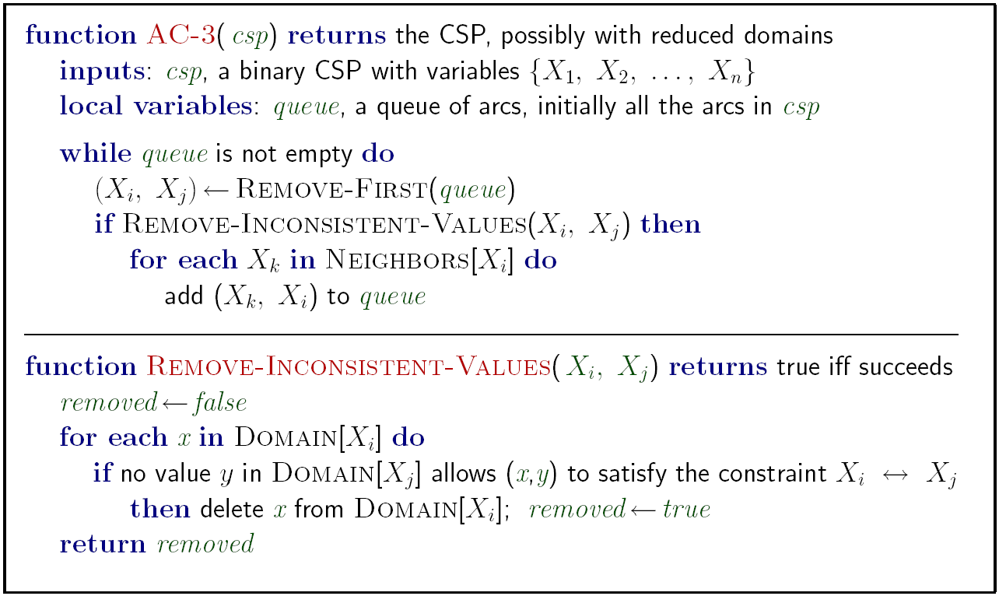
Enforcing Arc Consistency in a CSP
Runtime: O(n²d³), can be reduced to O(n²d²)
… but detecting all possible future problems is NP-hard – why?
Notes:
Auto-consistency (note initially nothing gets deleted/pruned since there are consistent options for all constraints for initial variable domains)
Flashes whenever something needs to be re-checked
n^2*d*d^2
Note: If you want to cut down on the worst case from n^2d^3 to n^2d^2, there's a trick where when you check consistency X->Y, for each value x you only go through y values until you find one that works. You stop there. Then, if you have to check it again, either that y value still works, or you continue until a new value does. This way, instead of d^2 d times, you collapse that into just d^2. You can read more here:
http://redwood.cs.ttu.edu/~yuazhang/publications/ac3-1-ijcai01.pdf

Slide 38


Limitations of Arc Consistency
After enforcing arc consistency:
Can have one solution left
Can have multiple solutions left
Can have no solutions left (and not know it)
Arc consistency still runs inside a backtracking search!
[Demo: coloring -- forward checking]
[Demo: coloring -- arc consistency]
Notes:
Demo:
CS188 javascript demos -> source -> exercises -> csps -> CSPs demos -> CSPs demos.html
Settings:
Graph = Complex
Algorithm = Backtracking
Ordering = None
Filtering = Forward Checking (first) / Arc Consistency (second)

Slide 39
Video of Demo Coloring – Backtracking with Forward Checking – Complex Graph

Slide 40
Video of Demo Coloring – Backtracking with Arc Consistency – Complex Graph

Slide 41
K-Consistency
Increasing degrees of consistency
1-Consistency (Node Consistency): Each single node’s domain has a value which meets that node’s unary constraints
2-Consistency (Arc Consistency): For each pair of nodes, any consistent assignment to one can be extended to the other
K-Consistency: For each k nodes, any consistent assignment to k-1 can be extended to the k^{th} node.
Higher k more expensive to compute
(You need to know the k=2 case: arc consistency)

Slide 42
Strong K-Consistency
Strong k-consistency: also k-1, k-2, … 1 consistent
Claim: strong n-consistency means we can solve without backtracking!
Why?
Choose any assignment to any variable
Choose a new variable
By 2-consistency, there is a choice consistent with the first
Choose a new variable
By 3-consistency, there is a choice consistent with the first 2
…
Lots of middle ground between arc consistency and n-consistency! (e.g. k=3, called path consistency)

